Slide 1
Fundamentals of Software E ngineering
LECTURE 3 : SOFTWARE TYPES
Farheen Tabassum MS Software Engineering EME,NUST
1

Slide 2
Software Engineering
Software
It is a program/set of programs containing instructions which provides desired functionality
Also composes of data structures that enables the program to manipulate information.

Slide 3
Software Engineering
Engineering
Set of steps which we follow to achieve a particular purpose
The process of designing and building some thing that serves particular purpose

Slide 4
Software Engineering
Systematic approach in which we aim to develop a quality software product and this systematic approach not only deals with the development of the software but also the maintenance of the software.

Slide 5
Why software engineering
Impose discipline to the work that can become quite chaotic
It ensures high quality software
It help us to build software product in timely manner.

Slide 6
What is work product
Result or outcome of software engineering.
Two aspects of work product
Software Engineer
User/customer

Slide 7
Aspects of work product
Software Engineer
Set of programs, the content (data) along with the documentation that is the part of the software

Slide 8
Aspects of work product
User/customer
The functionality delivered by the software that improves user experience and make user life better.

Slide 9
Software Engineering Focus on
Quality
Maintainability

Slide 10
Quality
functional | Non functional
Featured that are delivered by the software | Features other than the functions of the software e.g. robustness
To what extent we deliver a correct software | Also known as structural attributes or quality attributes.
We are getting the functions we are expecting
Quality or function according to requirement

Slide 11
Maintainability
Apart from quality software engineering also ensures that after the software has been developed and delivered the software should be maintainable.

Slide 12
Hardware vs. software
hardware | software
manufactured | Developed/Engineered
Relatively simple | complex
Build using components | Custom built
wear out | Deteriorate
Physical unit | Logical unit
Spare parts exists | No spare parts
Problem statement is clear | Problem statement is not clear
Multiples copies are costly than software | Multiple copies are less costly than hardware

Slide 13
Manufacturing vs. Development
Once a hardware product has been manufactured it is impossible or difficult to modify
In contrast, software products are routinely modified and upgraded
In hardware, hiring more people allows you to accomplishes our work, but the same does not necessarily hold true in software engineering

Slide 14
Manufacturing vs. Development
Unlike hardware, software costs are concentrated in design rather than production

Slide 15
Failure curve for software
When a hardware component wears out, it is replaced by a spare part
There are no spare part for software
Every software failure indicates an error in design or in the process through which design was translated into machine executable code
Therefore software maintenance involves considerably more complexity

Slide 16
Component based vs. Custom build
Hardware products typically employ many standardized design components
Most software continues to be custom built
The software industry does seem to be moving (slowly) toward component-based construction

Slide 17

Types of Software Application
2

Slide 18
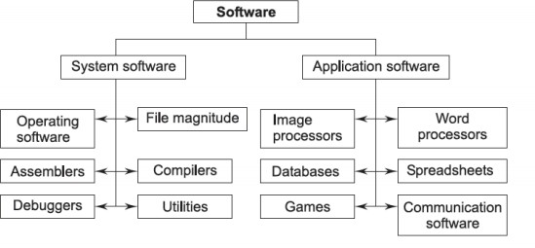
Types of Software

Slide 19
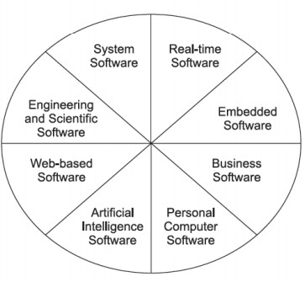
Software Application Types

Slide 20
Types of software
System software
They provide the platform for other software to run
They service other programs
Example
Operating system
Compiler
Device driver
Editor
File management

Slide 21
Types of software
Application Software
They are develop for particular purpose
They solve a particular
business need
Personal need

Slide 22
Types of software
Application Software
business need
Examples
payroll software
Management information system

Slide 23
Types of software
Application Software
Personal need
To make user world easier.
Examples
Normal gaming software
Personal computer software

Slide 24
Types of software
Engineering software
Solve scientific problems
Solve complex numerical problems
Example
Astronomical software
Genetic analysis

Slide 25
Types of software
Embedded software
Resides within a product and a system and is used to implement and control features and functions for end user and for the system it self
Give limited features and functionality
Example
key pad control for Microwave oven
Dashboard display
Cockpit control panel

Slide 26
Types of software
Artificial intelligence software
Induce human like intelligence in machine
Complex algorithm which are not numeric
Examples
Robotics,
Game playing software

Slide 27
Types of software
Legacy software
Very old and traditional software
Change from time to time
They do not have good quality

Slide 28
Types of software
Real world software
Control analyze real world in which they occur
You have to be sure what is the current data
Example
Weather forecasting
Satellite launching

Slide 29
Types of software
Web/mob application software
Web software | Mobile software
Those software that run on browsers | Those software that run on mobile devices, phones or tablets
Examples Online editing software | Examples Candy crush, wallpapers

